Slide 1
FYP5: Object Detection, Tracking and Suspicious Activity Recognition for Maritime Surveillance using Thermal Vision

Slide 2
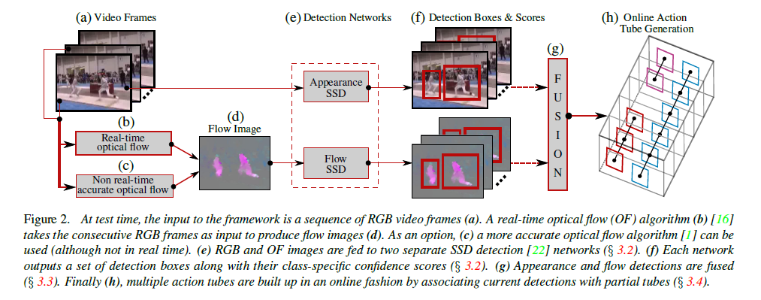
Recap on ROAD Architecture

Slide 3
New Proposed Idea for ICIP
Enhancing the performance of ROAD Framework
We are planning to do 3 main changes to the Original Framework
Improving the FMAP by changing the backbone – Done
Improving the TMAP by extrapolating bounding boxes for frames which have no detections – In progress
Improve the linking algorithm – Does not have a clear idea yet. If time permits, will decide on a novelty.

Slide 4
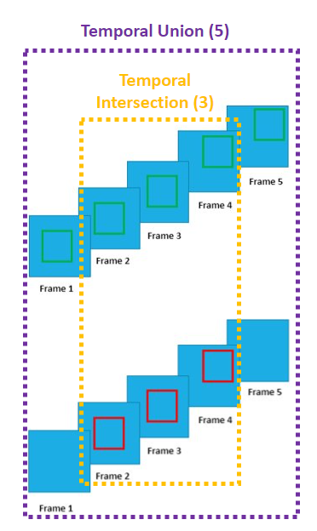
Metrics Used
1. fmAP
This is similar metric that is used in object detection models to evaluate their performances.
For each frame (image), the model's predictions for the localization of the activities are compared with the ground truths. Calculate IoU, threshold it and find AP for each video and average them.
2. tmAP (Temporal mAP) or vmAP (Video mAP)
This calculates the overall Temporal mAP score for the given video based on the Ground Truth Action Tubes and Detected Action Tubes (depends on linking algorithm).
First the Spatio-Temporal IoU threshold is calculated per detection:
First temporal IoU is calculated: T_{i}/T_{u}
Second, IoU between detections for the frames in the intersection is calculated
Third, calculate: (temporal IoU ) x (mean IoU)
Second, based on the IoU Threshold, construct the PR curve and calculate AP for each actions.
Third, tmap is calculated by averaging the action-wise APs.

Slide 5
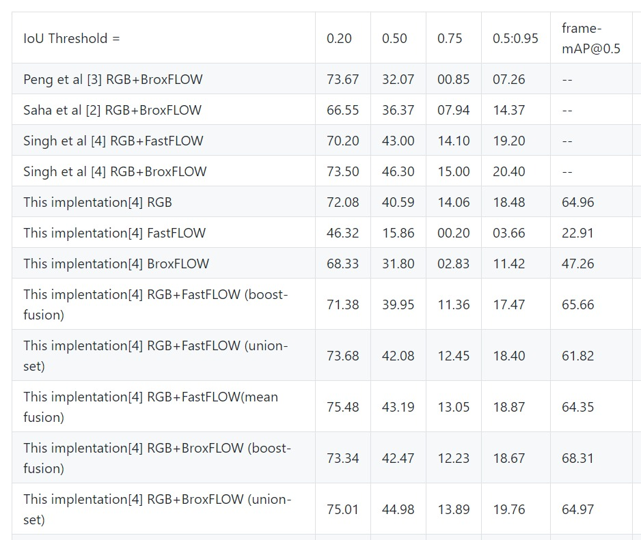
Improving the Accuracy - Results
Original ROAD Framework uses SSD (Single Shot Detector) – VGG16 as the backbone for activity detection
We used Centernet with VGG16
Average Precision (AP) @[ IoU=0.50:0.95 | area= all | maxDets=100 ] = 0.363
Average Precision (AP) @[ IoU=0.50 | area= all | maxDets=100 ] = 0.711
Average Precision (AP) @[ IoU=0.75 | area= all | maxDets=100 ] = 0.320
Average Precision (AP) @[ IoU=0.50:0.95 | area= small | maxDets=100 ] = 0.101
Average Precision (AP) @[ IoU=0.50:0.95 | area=medium | maxDets=100 ] = 0.305
Average Precision (AP) @[ IoU=0.50:0.95 | area= large | maxDets=100 ] = 0.408
Average Recall (AR) @[ IoU=0.50:0.95 | area= all | maxDets= 1 ] = 0.437
Average Recall (AR) @[ IoU=0.50:0.95 | area= all | maxDets= 10 ] = 0.507
Average Recall (AR) @[ IoU=0.50:0.95 | area= all | maxDets=100 ] = 0.507
Average Recall (AR) @[ IoU=0.50:0.95 | area= small | maxDets=100 ] = 0.222
Average Recall (AR) @[ IoU=0.50:0.95 | area=medium | maxDets=100 ] = 0.463
Average Recall (AR) @[ IoU=0.50:0.95 | area= large | maxDets=100 ] = 0.562
Online Real-time Multiple Spatiotemporal Action Localisation and Prediction - Singh et. al.
Results we got after changes

Slide 6
Previous Idea for ICIP

Slide 7
Training Procedure
Two distinct parameters for the clip size and batch size
Weight update (optimization step) is changed to mimic training with larger batch sizes.
The gradients are updated using the loss for each clip (frames M) and accumulated over a batch
After N number of clips are passed, the weights are updated
We use N = 16 as the batch size and M = 10 as the clip size
The learning rate scheduler:
Initially started with 0.001
At epoch 15, 50 and 80 the lr is reduced by factor of 10
Based on the paper titled "Two-Stream Convolutional Networks for Action Recognition in Videos"

Slide 8
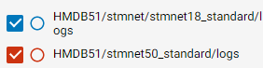
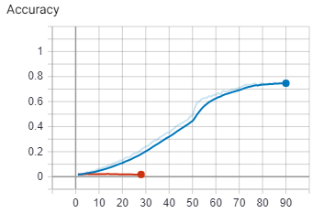
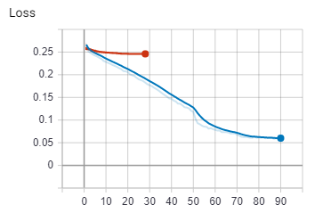
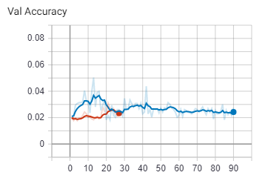
Activity Recognition – Training Results
Trained two versions of our model
STMNet18 - Model overfits on the data set after 15th Epoch
STMNet50 – Model fails to learn, and accuracy is at 2%even after 30th epoch
Training Accuracy and Loss
Validation Accuracy

Slide 9
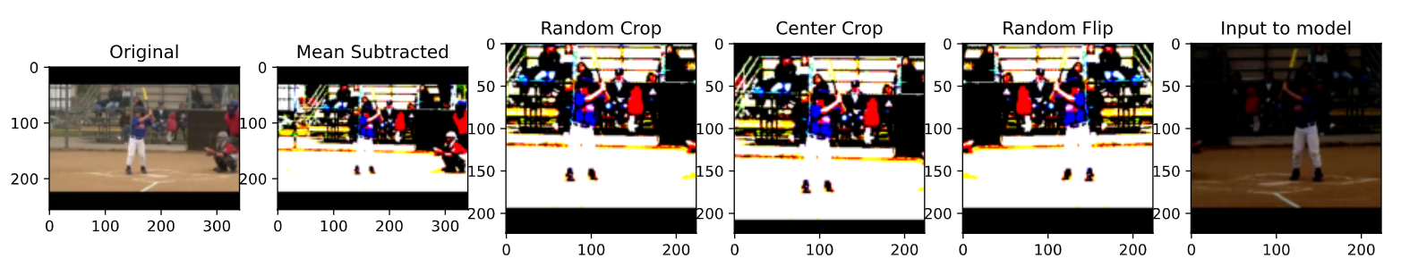
Data Loader
Modifications were done based on publications on Activity Recognition task.
Choosing a random clip per video with constant time gap between them
Applying data augmentation
Mean Subtraction
Random Cropping (Only in training phase)
Random Horizontal Flipping with probability of 0.5 (Only in training phase)
Central Cropping (Only in validation phase)
Action Label – swing_baseball

Slide 10
Plans and Next steps
Using UCF-101 to pre-train the network and finetune on HMDB-51
Parameter tuning for the current training procedure – to check whether the results can be improved.
Start working on the temporal localization of the actions
Start working on a Survey Paper (targeting ICIP) for Temporal Localization, Activity Classification and Spatio-Temporal Localization (Given that we don’t obtain adequate results from any of the above-mentioned steps.)

Slide 11
Progress in FYP

Slide 12
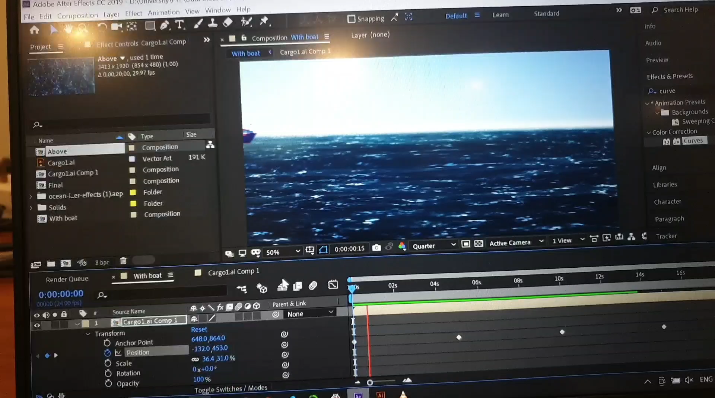

Data Creation of our own

